Slide 1
The AP® Program
at the ELGIN HIGH SCHOOL GIFTED AND TALENTED ACADEMY

Slide 2
The Basics
Advanced Placement Program® (AP®) courses are college-level courses offered in high school. AP courses reflect what is taught in top introductory college courses
At the end of course, students take AP Exams—standardized exams that measure how well students have mastered college-level course work.
Students who do well on AP Exams can earn credit and/or placement into advanced courses in college.

Slide 3
The Benefits of AP Courses
AP courses can be challenging, but it’s work that pays off.
AP courses are often the most interesting and fulfilling courses a student takes in high school.
AP teachers are among the most prepared, dedicated, and inspiring teachers at their schools.
Students develop confidence, and learn the study habits and time management skills essential for success in college.

Slide 4
AP and College Admission
Colleges rank “Grades in college prep courses” and “Strength of curriculum” as the top two factors in the admission decision.*
85% of selective colleges and universities report that a student’s AP experience favorably impacts admission decisions.**
“We look favorably on students who have taken AP courses. The presence of AP courses is a sign that a student has chosen to challenge him/herself.”
—Admission Officer
* 2009 State of College Admission, NACAC
** Unpublished institutional research, Crux Research Inc. March 2007
Notes:
**For the purposes of this study, “selective” institutions were defined as those where less than 70 percent of applicants were admitted, the mean SAT score was 1025 or higher, and mean ACT score was 22 or higher.

Slide 5
AP Courses Offered by Our School:
Required with the Academy at some point:
AP World History
AP Biology
AP US History
AP European History
AP English Literature and Composition
AP English Language and Composition
AP Chemistry or AP Physics or AP Environmental Science
AP US Government
AP Macroeconomics
AP Statistics or AP Calculus AB or AP Calculus BC
Additional Electives
AP Human Geography
AP Art History
AP Spanish Language
AP Psychology

Slide 6
What Are AP Courses Like?
AP courses typically demand more of students than regular or honors courses.
Classes tend to be fast-paced and cover more material than typical high school classes.
More time, inside and outside of the classroom, is required to complete lessons, assignments and homework.
AP teachers expect their students to think critically, analyze and synthesize facts and data, weigh competing perspectives, and write clearly and persuasively.
Notes:
Discussion topic: How can parents help support their children?
Encourage time management
Remind them to prioritize
Recommend they form study groups
Designate specific areas for homework and studying

Slide 7
AP Exams
AP Exams are administered by schools worldwide on set dates each May.
Exams usually last around three hours.
Each AP Exam contains:
Multiple-choice questions
Free-response questions (essay, problem-solving, oral response)

Slide 8
AP Exam Fees
AP Exam fee for 2012 is $87 per exam.
For students with financial need, the College Board provides a $22 per exam fee reduction.
Notes:
If your school is located outside of the United States, Canada, and U.S. Territories and Commonwealths, and is not a U.S. Department of Defense Dependents School, the 2012 exam fee is $117. Fees vary at some private College Board-authorized testing centers outside of the United States.
Information about AP fee reductions can be found at: www.collegeboard.com/apfeereductions
Information about additional state and federal funding for AP Exam fees can be found at: www.collegeboard.com/apexamfeeassistance

Slide 9
Why Take AP Exams?
Most two- and four-year colleges and universities in the United States offer credit or advanced placement for qualifying AP Exam scores.
Credit: Students earn credit toward their college degrees.
Advanced placement: Students can skip introductory courses and move directly into higher-level classes, and/or fulfill general education requirements.

Slide 10
AP Credit Expands Students’ Options
College credit earned through AP Exams allows students to move into upper-level college courses sooner, pursue a double major, and gain time to study and travel abroad.
“As a freshman, I was able to skip general education requirements and head straight into the higher-level classes I wanted to take. Taking AP Exams literally saved me semesters of time.”—Brent Wiese, University of Iowa

Slide 11
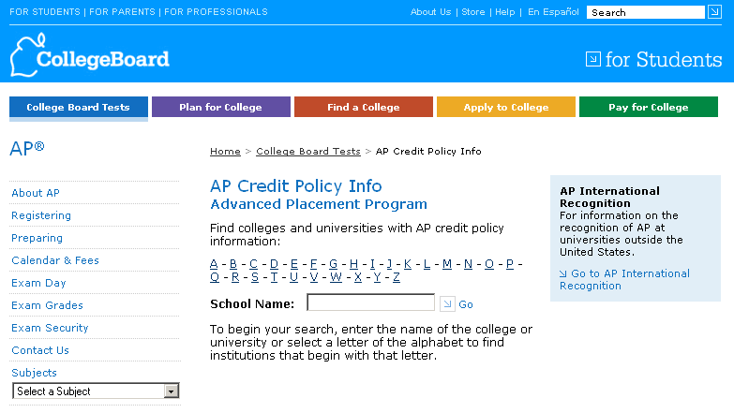
AP Credit Policy Information
Information about AP credit and placement policies at many colleges and universities is available at www.collegeboard.org/apcreditpolicy.
Search by college or university name or by letter of the alphabet
You will see two things for each school:
A link to the college’s own Web page that details its AP credit and placement policies.
A statement by the college or university about its AP policy.

Slide 12
AP Helps Students Graduate on Time…
Students who take AP courses and exams are much more likely than their peers to complete a college degree on time.
Only one in four students who enter college complete a bachelor’s degree in four years.*
A recent study** showed that students taking AP courses and exams were much more likely to earn a college degree in four years.
For example, AP English Literature students had four-year college graduation rates that were 62% higher than students that had not taken AP English Literature.
* IPEDS database, 2008
** Linda Hargrove, Donn Godin, and Barbara Dodd, “College Outcomes Comparisons by AP and Non-AP High School Experiences.” The College Board, 2008.
Notes:
* Of the remaining 73% of students who do not complete a bachelor’s degree in four years, approximately 25% earn a bachelor’s degree in 5 or 6 years, approximately 25% drop out or take more than 6 years to earn a bachelor’s degree, and approximately 23% transfer to another college or university, with typically lower graduation rates than students who do not transfer.

Slide 13
… and Save Money
Students who take five years or more to graduate can spend $8,000-$27,000 for each additional year in college.
The typical college cost per year for a four-year public institution is $8,142 for in-state students and $19,670 for out-of-state students.*
Students attending private institutions might expect to incur $27,389 for each additional year it takes to earn a bachelor’s degree.*
* Costs include tuition, fees, and books and supplies only, and do not include room, board, and other living expenses. Average Estimated Undergraduate Budgets, 2009-10 (Enrollment-Weighted). The College Board, ”Trends in College Pricing,” 2009.

Slide 14
AP Boosts Eligibility for Scholarships
31% of colleges and universities consider a student’s AP experience when making decisions about which students will receive scholarships.*
“Having the AP Exam score can make the difference when it comes down to awarding precious scholarship dollars.”
—Edwina Harris Hamby, former Dean of Admission, Fisk University
* Unpublished institutional research, Crux Research Inc. March 2007

Slide 15
AP and College Success
A recent study* showed that students who earned a 3, 4, or 5 on the AP Exam had higher first-year college grade point averages and were more likely to return for the second year of college than non-AP students of similar ability.
“One of the best standard predictors of academic success at Harvard is performance on Advanced Placement Examinations.”
—William Fitzsimmons, Dean of Admissions & Financial Aid, Harvard University
*Krista Mattern, Emily Shaw, and Xinhui Xiong, “The Relationship Between AP Exam Performance and College Outcomes” (2009), The College Board.

Slide 16
Learn More
For more information about AP courses and exams visit www.collegeboard.org/apstudents.

